Slide 1
Employee Data Analysis using Excel
STUDENT NAME: PRIYANKA RAI S
REGISTER NO: 322200024, asunm1353322200024
DEPARTMENT: B.COM HONOURS
COLLEGE: ANNA ADARSH COLLEGE FOR WOMEN

Slide 2
PROJECT TITLE
EMPLOYEE WORK TIME ANALYSIS USING EXCEL

Slide 3


AGENDA
Problem Statement
Project Overview
End Users
Our Solution and Proposition
Dataset Description
Modelling Approach
Results and Discussion
Conclusion
3/21/2024 Annual Review

Slide 4

PROBLEM STATEMENT
To optimize productivity and ensure fair workload distribution, it's crucial to understand how employee work time aligns with full-time equivalent (FTE) standards. Organizations currently lacks a systematic approach to analyze this, leading to potential inefficiencies and imbalanced workloads. A comprehensive analysis of employee work time by FTE is needed to improve resource allocation, operational efficiency, and workforce balance.

Slide 5

PROJECT OVERVIEW
Organizations struggle to optimize productivity and maintain fair workloads without understanding how employee work time aligns with Full-Time Equivalent (FTE) standards. This lack of analysis can lead to inefficiencies, imbalanced workloads, and poor resource allocation. A thorough FTE-based work time analysis is essential to improve operational efficiency, ensure fair task distribution, and enhance workforce management.
.

Slide 6

WHO ARE THE END USERS?
The End Users Are Human Resource Team, Managers, Team Leads And Employees
Notes:
The end users are human resource team, managers, team leads and employees

Slide 7

OUR SOLUTION AND ITS VALUE PROPOSITION
Conditional formatting for missing figures
Filter for removing blanks
Pivote table for summary
Graph for data visualization
Notes:
Conditional formatting for missing figures
Filter for removing blanks
Pivote table for summary
Graph for data visualization

Slide 8
Dataset Description
EMPLOYEE DATA – KAGGLE
9– FEATURES
4 - FEATURES
LIST THE NAME OF FEATURES
NAME
GENDER
FTE
EMPLOYEE TYPE
Notes:
EMPLOYEE DATA – KAGGLE
9– FEATURES
4 - FEATURES
LIST THE NAME OF FEATURES
Name, gender, fte, employee type

Slide 9

THE "WOW" IN OUR SOLUTION
CONDITIONAL FORMATTING
3/21/2024 Annual Review
9
Notes:
Data collection
Feature collection

Slide 10
MODELLING
Data collection
Name
Gender
Feature collection
FTE
Employee type
Data cleaning
Gender
Work time analysis
Pivote table
Filter
Summary
Graph
10

Slide 11
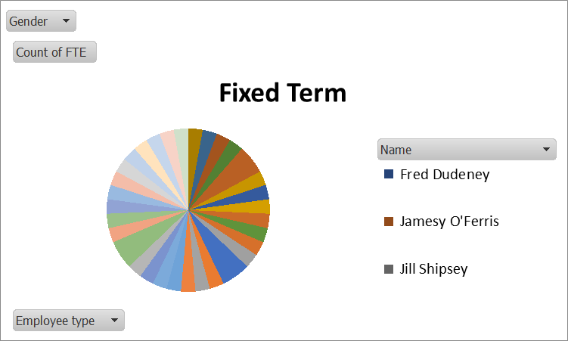
RESULTS
11

Slide 12
conclusion
Through the analysis it is observed that most of the employees have achieved equal to or more than 1 FTE
Notes:
Through the analysis it is observed that most of the employees have achieved equal to or more than 1 FTE

